Slide 1

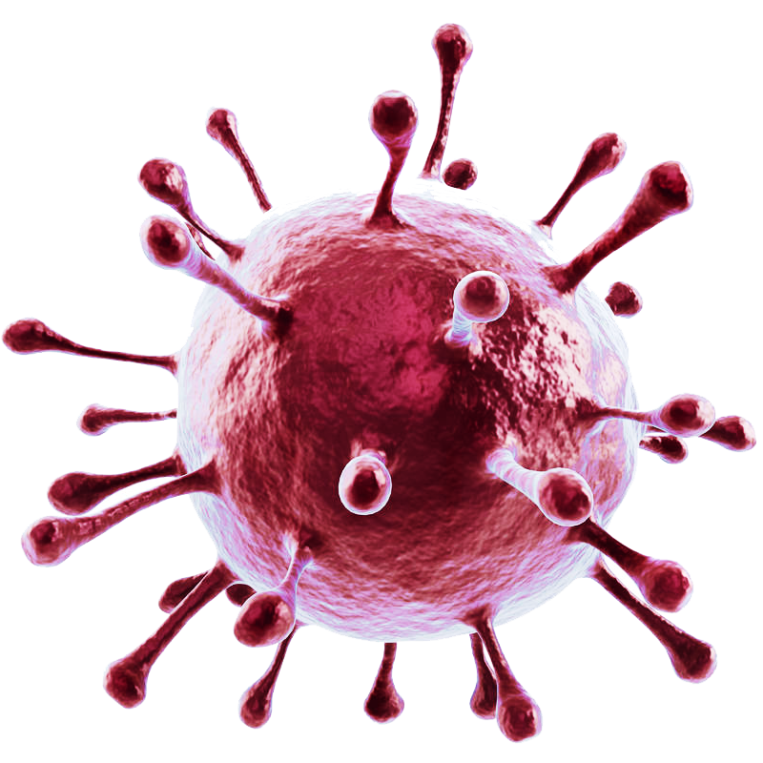
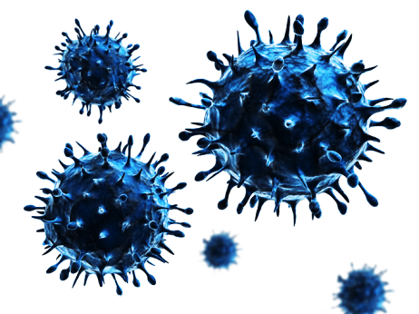
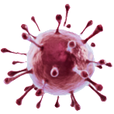
COVID-19
Coronavirus
PRESENTED BY-
SHIVANI TIWARI
BSC Nursing 5th Semester

Slide 2


CONTENTS
DEFINITION
EPIDEMIOLOGICAL TRAID
INCUBATION PERIOD
M0DE OF TRANSMISSION
CLINICAL MANIFESTATION
RISK FACTORS
DIAGNOSTIC EVALUATIONS
PREVENTION & CONTROL
TREATMENT
COMPLICATIONS

Slide 3
DEFINITION
COVID-19 , is short for “ coronavirus disease 2019 is a respiratory illness caused by a novel coronavirus known as SARS- CoV-2.
It was first identified in December 2019 in the city of Wuhan , China , and has since spread globally leading to a pandemic.

Slide 4
EPIDEMIOLOGY

AGENT : Causative virus is SARS-CoV-2 . the virus has a zoonotic source closely related to bat-origin SARS-like coronavirus.
SOURCE : The person infected by the novel coronavirus are the main source of infection.
TRANSMISSION : Direct person to person transmission occurs when infected person sneeze, cough, or talk.

Slide 5
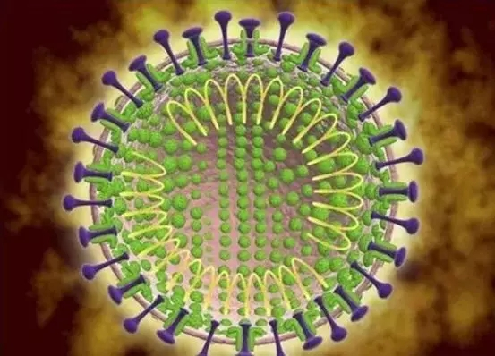
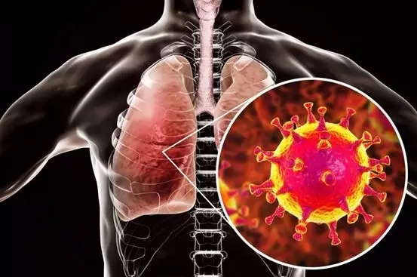
INCUBATION PERIOD
The incubation period of COVID-19 is
14 days.
CAUSES
SARS-CoV-2 Virus
It may spread from animals e.g., Bats , Camels etc.
some can be idiopathic

Slide 6
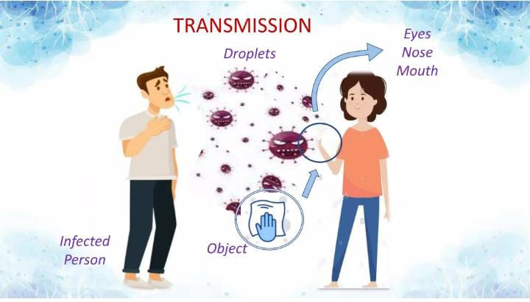
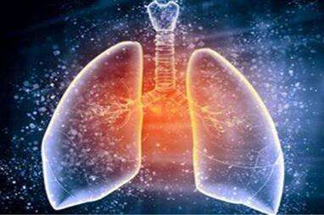
contact
MODE OF TRANSMISSION
Respiratory droplets
Contact with infected person
Contact with contaminated surface
Airborne transmission
Fecal-oral transmission
crowded public place
.

Slide 7
CLINICAL MANIFESTATION
Many people with covid-19 have almost no symptoms.
Fever with chills
Dry cough
Trouble breathing
weakness & tiredness
headache
Running nose
Pneumonia
Loss of sense of smell & taste
Nausea , Vomiting
Sore throat
Diarrhea
Muscles & body Ache
Skin rash
Organ failure

Slide 8
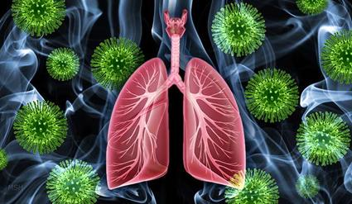
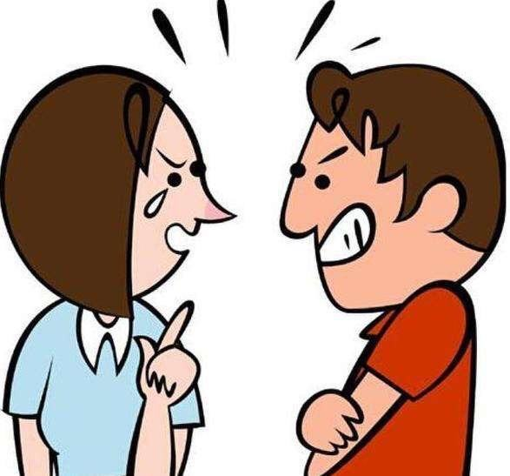
RISK FACTORS
Older people
Obesity
Chronic respiratory disease
Heart disease
High blood pressure
Diabetes
Cancer

Slide 9
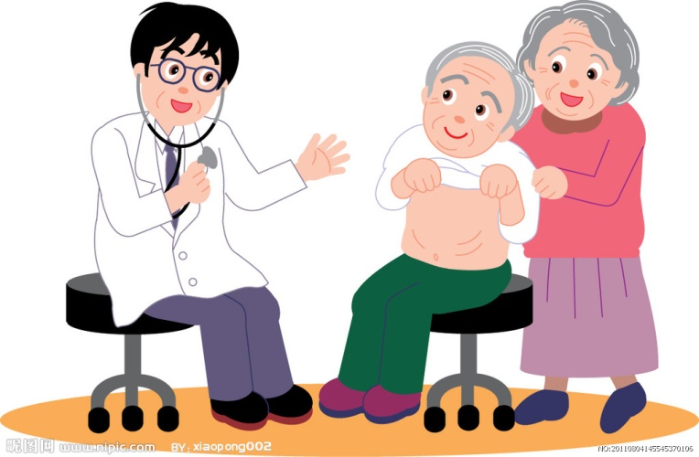
DIAGNOSTIC EVALUATION
Medical history
Physical examination
Symptoms assessment
Antigen test
Serology test
Chest X-ray
CT scan

Slide 10
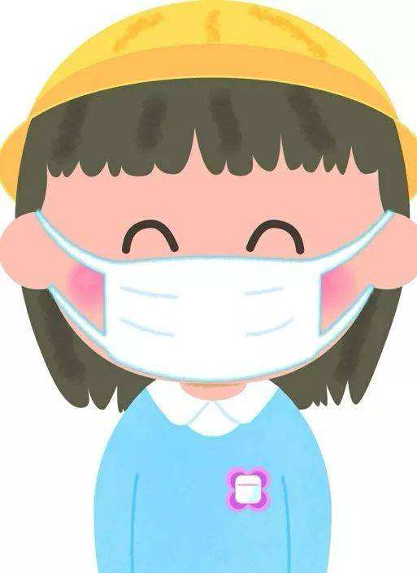
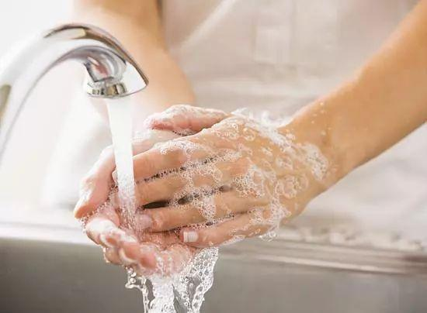
PREVENTION
Hand hygiene
Mask wearing
Social distancing
Respiratory etiquettes
Vaccination
Healthy diet

Slide 11
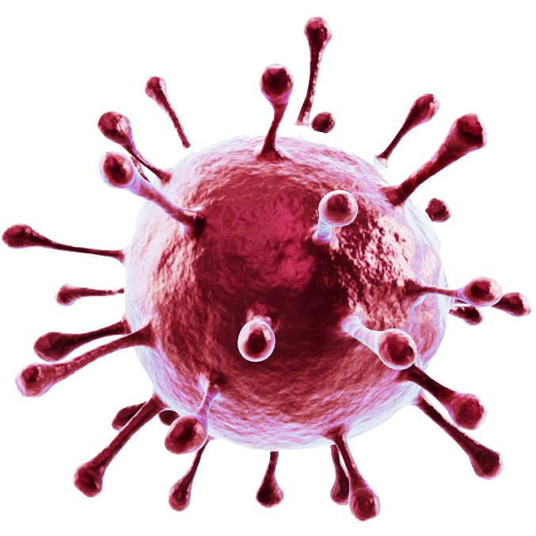
CONTROL MEASURES
Quarantine
Travel restriction
Public health compaign
testing & diagnosis
Contact tracking
Self isolation
Hand hygiene
Eat fresh food & vegetables

Slide 12
TREATMENT
Oxygen therapy
Antiviral medications : Lopinavir, ritonavir.
Corticosteroids: Dexamethasone
Immunomodulatory therapies
supportive care
Psychological support
Healthy diet pattern

Slide 13
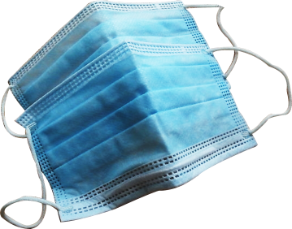
WHAT TO DO OR NOT
DO | DO NOT
Use handkerchief or a tissue to cover your face while coughing or sneezing. | Do not spit in the open, always use a wash basin for spit.
Wash hands immediately after you have covered your sneeze or cough. | Do not eat anything without washing your hands.
Cover your sneeze into your bent upper arm in case you are not carrying a tissue or a handkerchief. | Do not touch your eyes, nose and mouth with unwashed hands.

Slide 14
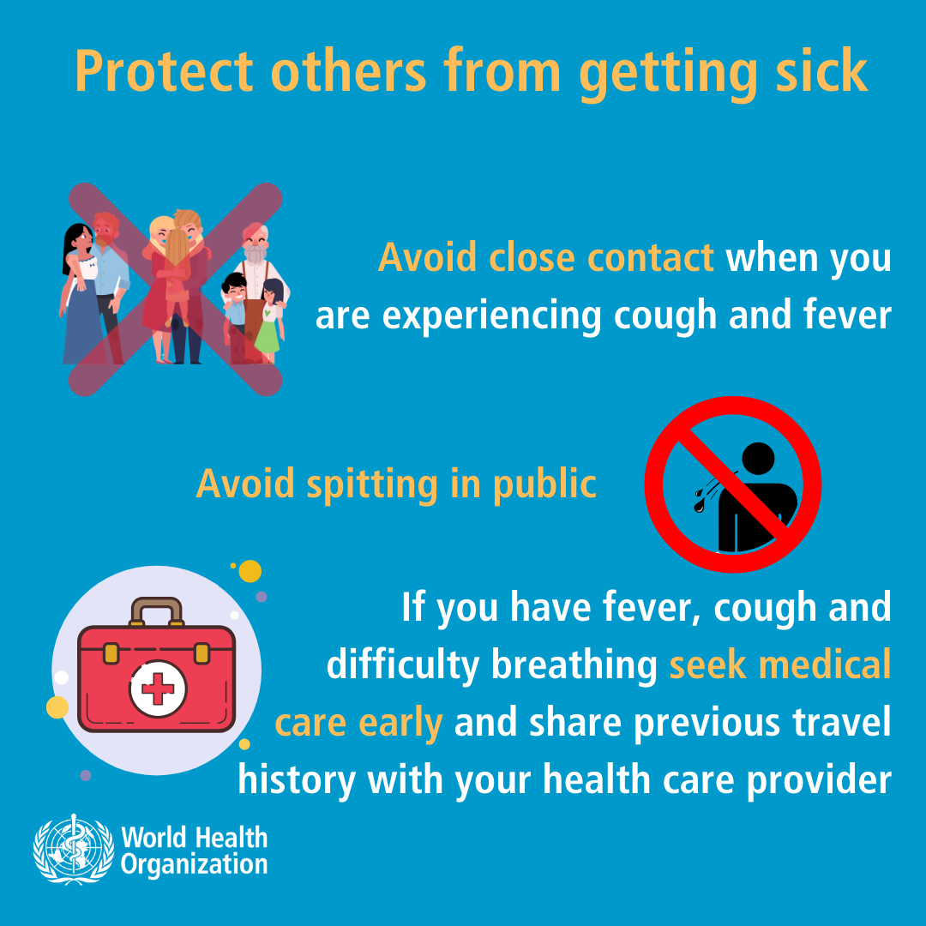
Defenses guide

Slide 15
VACCINES
In India there are 3 Covid-19 vaccines.
COVISHIELD : Covishield is brand name for AstraZeneca\ Oxford vaccine. It is a viral vector based vaccine.
COVAXIN : Covaxin is an inactivated virus vaccine.
SPUTNIK V : It is develped by the Gamaleya Institute of Epidemiology and Microbiology in Russia.

Slide 16
COMPLICATIONS
Acute respiratory failure
Pneumonia
Acute Respiratory Distress Syndrome
Acute liver injury
Septic shock
Blood clots
Chronic fatigue
Cardiac injury
Death

Slide 17
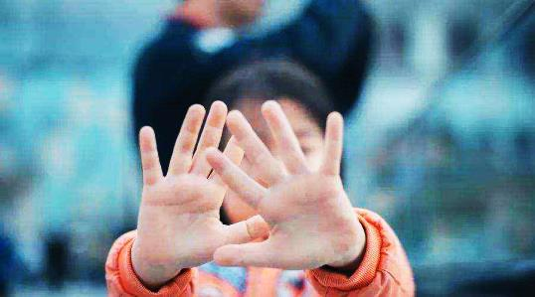
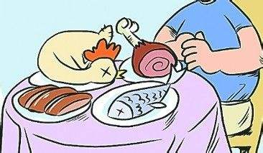
POST-COVID CARE
Drink plenty of water
Regular breathing exercises
maintain hand & personal hygiene
Adequate sleep
Avoid smoking & alcohol
Take healthy diet : green vegetables, fruits, salad etc.
Don’t miss vaccination.
Healthy lifestyle
.

Slide 18


Slide 19
Thank You

